Slide 1
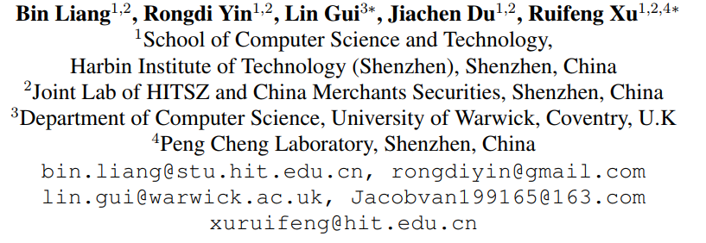
ATAI
Chongqing University of Technology
Advanced Technique of Artificial Intelligence
Chongqing University of Technology
2020COLING_Jointly Learning Aspect-Focused and Inter-Aspect Relations with Graph Convolutional Networks for Aspect Sentiment Analysis
Ling Zhu
Code:https://github.com/BinLiang-NLP/InterGCN-ABSA

Slide 2
Outline
Introduction
Motivation
Approach
Experiments
Conclusion

Slide 3
Introduction

Slide 4
Motivation
explore a novel solution to construct the graph for each instance, in which both aspect-focused and inter-aspect syntactical dependencies are introduced.
2) An Interactive Graph Convolutional Networks model is proposed to derive aspect-specific sentiment features by interactively extracting the sentiment relations within aspect words and across different aspects in the context.

Slide 5
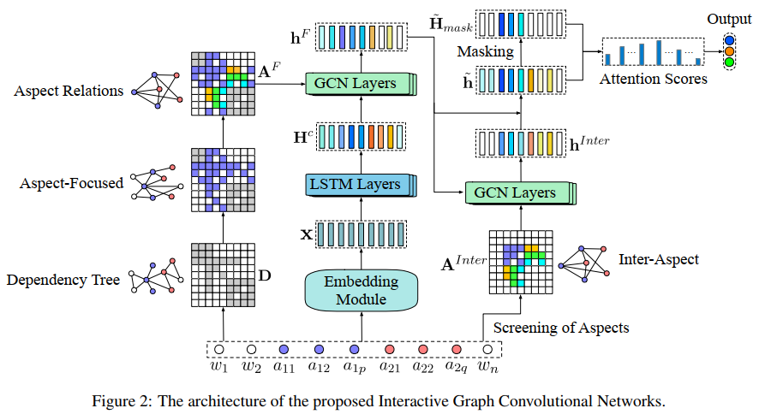
Approach

Slide 6
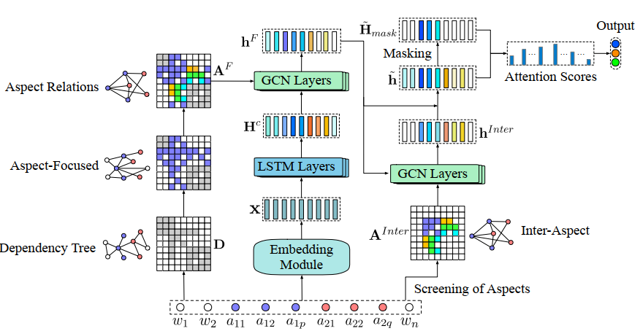
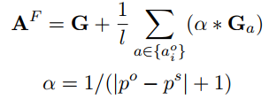
Approach
Producing Ordinary Graphs over Dependency Tree
Refining Graphs for Specific Aspect

Slide 7
Approach
Constructing Inter-Aspect Graphs

Slide 8
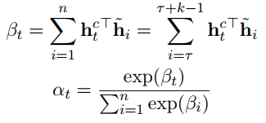
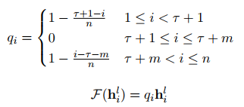
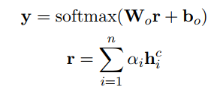
Approach
Interactive Graph Convolutional Network

Slide 9
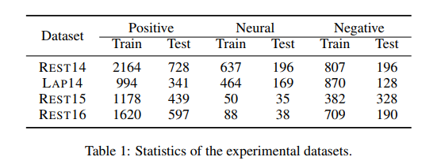
Experiments

Slide 10
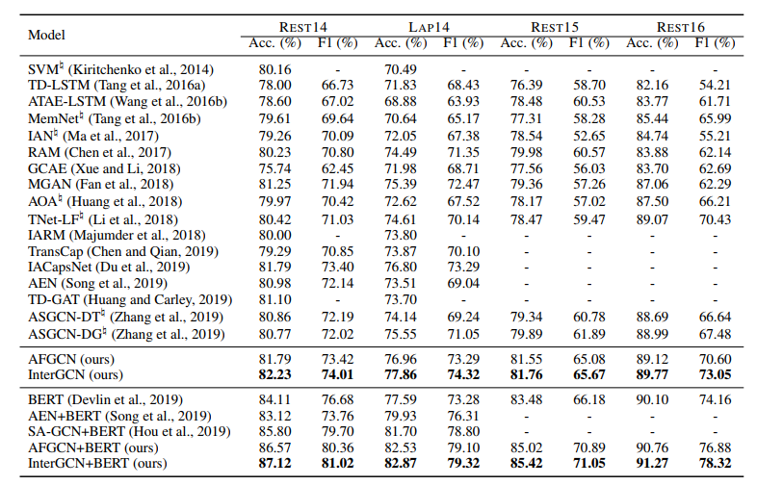
Experiments

Slide 11
Experiments

Slide 12
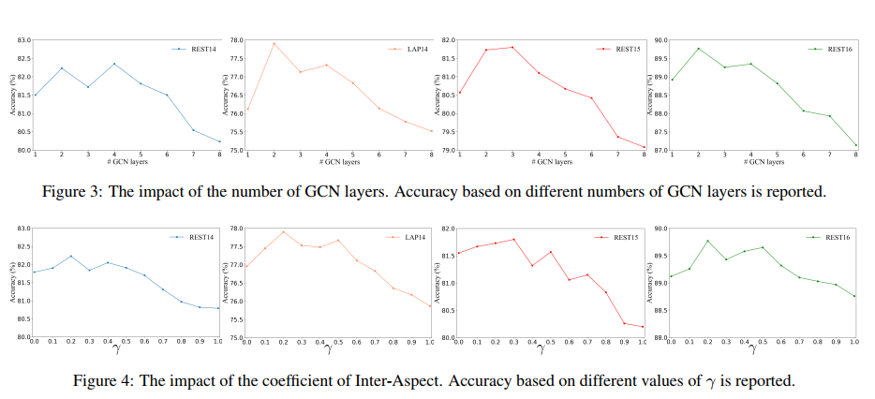
Experiments

Slide 13
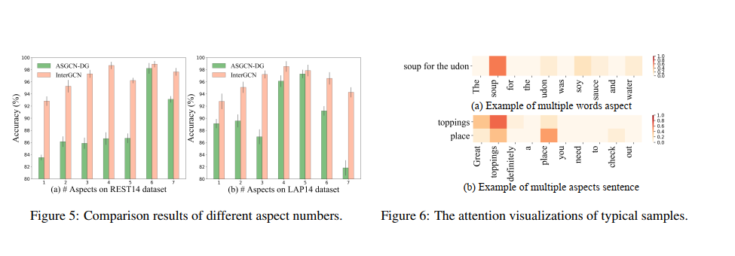
Experiments

Slide 14
Conclusion
explore a novel solution of constructing aspect-focused and inter-aspect dependency graphs for aspect sentiment analysis
the proposed InterGCN model can pay significant attention to the key aspect words when dealing with multiple words aspect, and connect the valuable sentiment features of related aspects when considering an aspect without distinct sentiment expression

Slide 15
Thanks

